Slide 1
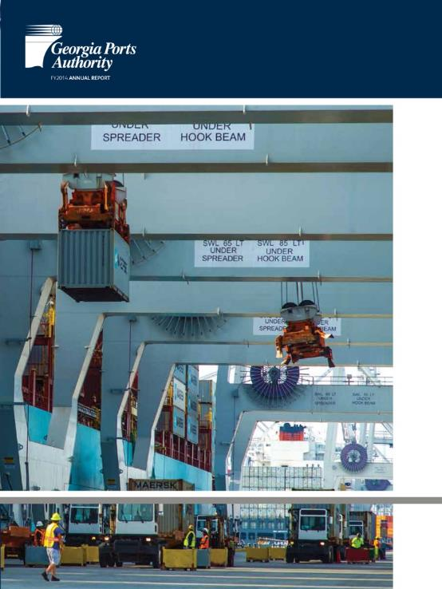
Georgia Ports Authority
FY2014 Annual Report
Annual Report

